Slide 1
CCD & Magnetic optical Driver

Slide 2
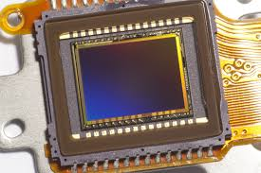
CCD
A charge coupled device (CCD) or image sensor is an light sensitive integrated circuit etched onto a silicon surface to form elements called pixels.
It stores and displays the data for image can be read by electronics and turned into a digital copy of the light patterns (color spectrum) falling on the device.
The data is stored in terms of pixels which has arranged by memory array.

Slide 3
Application of CCD
Commonly used in digital still and video camera as it can improve resolution.
Astronomical telescopes, scanners, and bar code readers etc.

Slide 4
Magnetic Optical drive
A magneto-optical drive is a kind of optical disc drive capable of writing and rewriting data upon a magneto-optical disc.
The magneto-optical (MO) drive is a popular way to back up files on a personal computer. As MO device employs both magnetic and optical technologies to obtain ultra-high data density.

Slide 5
Data processing
The design of the drive allows the inserted disk to be exposed to the magnetic head on one side and to the laser on the another side.
Both the laser and the magnet are used to write data onto the diskette.
Write operation: The laser heats up the diskette surface (magnetic medium) so it can reduce magnetic field and allow the region of magnetization to be precisely located and confined.
Read operation: A less intense laser is used to read data from the diskette. The process is based on magneto- optical Kerr Effect.

Slide 6
Features
Its capable of high data intensity by means of magnetic read/write heads and laser.
The magneto optical disk allows multiple rewrites.
This is a special removal disk.
Its writing speed is faster than HDD but slower than CD/DVD.

